Slide 1
Internet market
Go Final Project

Slide 2
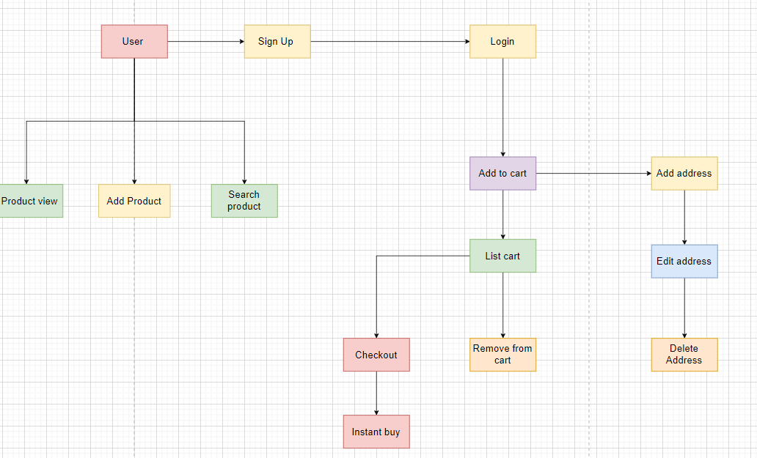
Scheme

Slide 3
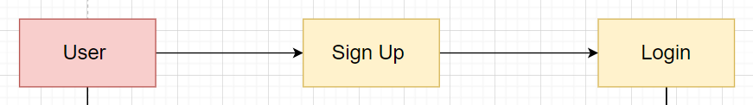
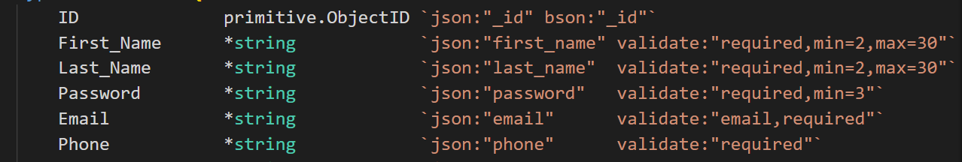
User
User should sign up to system
and sign in.

Slide 4
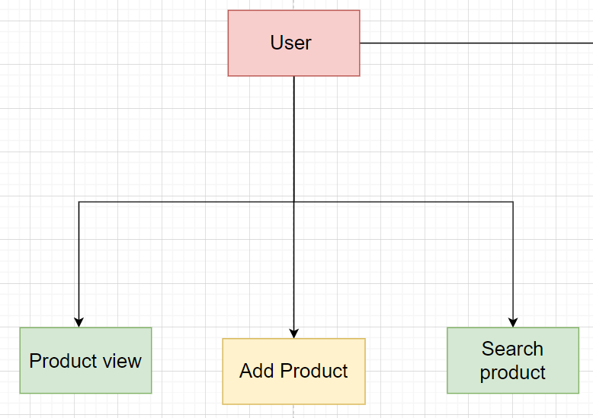
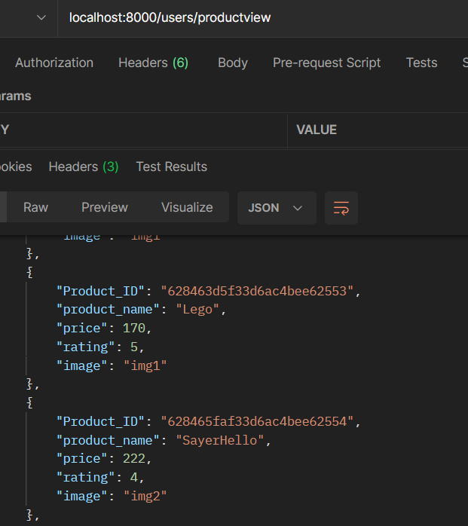
User can see product list and search

Slide 5
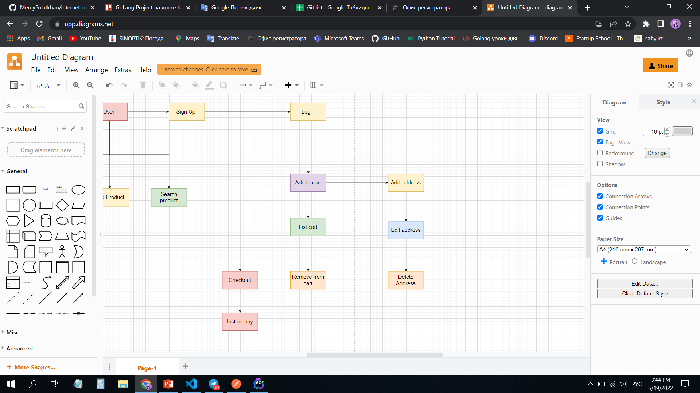
After login:
User can add products
to cart and write address
After having products
in cart, user can purchase product!

